Slide 1
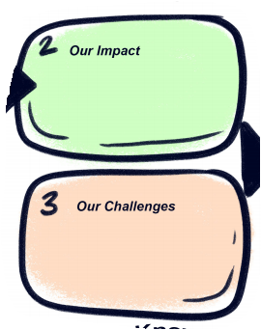
MY ORGANIZATION

Slide 2


FIGHTING HUNGER: COLLECTIVE ACTION AND ADVOCACY
Hunger Advocacy 101
– MAHN Conference–
May 12, 2017
Emma Kornetsky
Manager, Government Affairs
www.philabundance.org
Kathy Fisher
Policy Director www.hungercoalition.org
Notes:
2
Introductions

Slide 3

Overview
1. Hunger in our Communities
2. Role of Advocacy
3. Current Issues
  SNAP
  SFPP
  PASS
4. What you can do
Notes:
Road map for discussion today

Slide 4
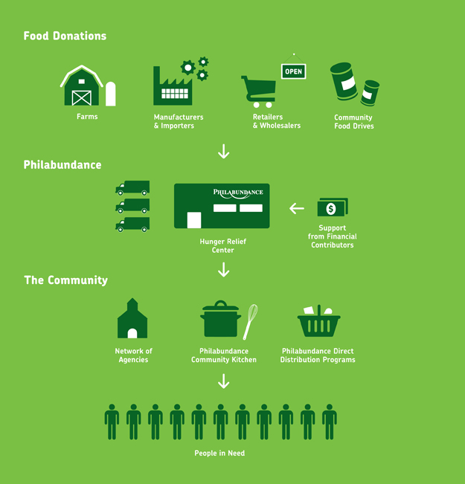
How We Work
Notes:
Food Donations:
Farms
Manufacturers & Importers
Retailers & Wholesalers
Community Food Drives
Last year we distributed ~27M pounds of food
50% - refrigerated (like produce & dairy)
33% - dry
17% - frozen (meat)
Approximately
40% GAH from retailers
15% Produce from the Port
15% Service Area Food Industry
10% Government
5% Food Drives
5% Purchased
Philabundance
Hunger Relief Center – accepts volunteers. Approximately 22,000 people/year lend their support.
The Community:
Network of agencies – many are faith based and volunteer run
Philabundance Community Kitchen
Philabundance Direct Distribution Programs (KB, FFA, CSFP)
Getting food in the hands of people in need.

Slide 5

Coalition Overview
Founded in 1996, the Coalition Against Hunger works to address hunger through education, outreach and advocacy.
Hunger Fighters Network
SNAP
Enrollment Campaign
Advocacy
Community and Nutrition Education
Notes:
5
It’s important to fight hunger BEYOND THE SOUP KITCHEN. We do need to address immediate needs, but also know SNAP can help a family afford multiple meals throughout the month for 12 months of the year. In addition better policies can help more families access nutritious food. Large scale changes are needed to actually END hunger in America.
Our 3 pronged approach:
For people facing immediate need for food → food pantries and soup kitchens. We refer callers to these resources, as well as provide support to the people running them so that they can stay open and serving the public.
SNAP → more stable, monthly support for those eligible. We screen for eligibility and help callers apply over the phone with us, and provide case management. We are a knowledgeable, accessible middleman between individuals and the county assistance office. SNAP helps people to access healthy, affordable food, but SNAP benefits often do not last the entire month. Therefore, we also need to take a broader approach to fighting hunger . . .
Advocacy encourages long-term solutions to food insecurity; through our policy work at the local, state, and federal level.

Slide 6

What Do We Advocate For?
We advocate at the local, state, and federal level for responsible policy solutions to hunger
Legislative advocacy
Influencing laws and funding levels
Administrative advocacy Influencing government rules, regulations, and policies
Program advocacy
Influencing how programs are implemented on the ground
Notes:
Depending on the issue(s), the approach may be less public. Many other targets for advocacy; you can work to influence programs, procedures, practices on any level. EXAMPLES
Federal – Farm Bill; Budget/funding; Child Nutrition Reauthorization
State – Briefing paper to new Governor; Advocating for $$ for SFPP and PASS; Meetings w/DHS, PDE, Ag, etc. re: administration of various nutrition programs (such as pushing DHS to take a specific federal option, like ESAP)
City – FPAC Mayoral Forum; Testimony to City Council
Program advocacy - School Breakfast Challenge

Slide 7

What do we mean by hunger?
How big is the problem?

Slide 8
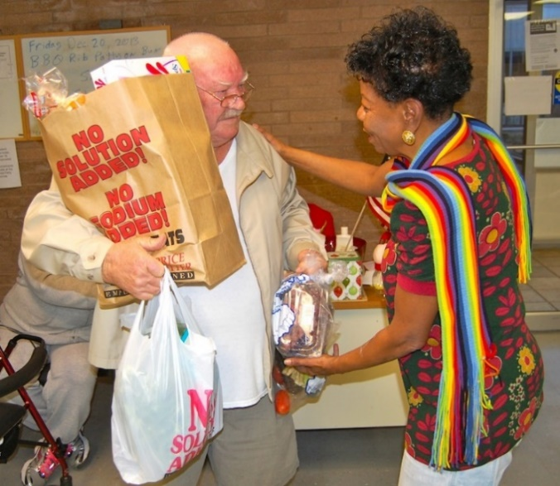

Scope of Hunger
13.4% – more than 1 in 8 Americans are food insecure
= 42.2 million people
13.1% – 1 in 8 Pennsylvania residents are
food insecure = 1,670,000 people
9.7% - about 1 in 10 Montgomery County residents are food insecure = 78,540 people
Source: Feeding America Map the Meal Gap (2015 data, 2017 report)

Slide 9
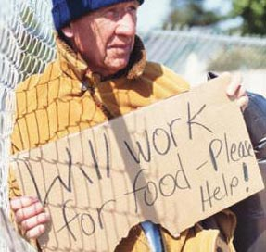
Root of Hunger = Inadequate Income
Inability to afford enough nutritious food has many causes:
  Low wages/part-time hours
  Lack of paid leave and/or sick days
  Barriers to work including physical and mental health issues
  Low-literacy and/or mismatch of skills for current labor market
  Other demands on income
Consider: A minimum wage earner, working 40 hours/week, 52 weeks/year earns $15,080, just 75% of the poverty level for a family of three
Notes:
Many, many reasons and challenges contribute to people not having enough money to buy the food they need, leading to hunger.
Many of these challenges have no easy solutions, but MANY options that can help: raise the minimum wage; require paid sick leave and consistent work schedules; improve services for mental/behavioral health issues; invest more in training/re-training programs . . .

Slide 10
What does it mean to live in poverty?
Poverty rates are determined by the number of members in a household and their annual income
These are gross income limits (i.e. before, not after taxes)
These rates do not vary from state to state (except AK and HI), despite significant differences in cost-of-living.
Montgomery County poverty rate = 6.6% (53,939 people)
 | Federal Poverty Line | PA SNAP Income Limit | Reduced-price School Meals & WIC Income Limit
Household # | 100% | 160% | 185%
1 | $11,880 | $19,008 | $21,978
2 | $16,020 | $25,632 | $29,637
3 | $20,160 | $32,256 | $37,296
4 | $24,300 | $38,880 | $44,955
Notes:
Clearly, Poverty and Hunger are sides of the same coin. Those in poverty struggle with hunger . . .
SOURCE: Federal Register, Vol. 81, Pages 4036-4037, January 25, 2016

Slide 11
Food Insecurity & Poverty
Food insecurity and poverty are related, but not the same
Nationally, 26% of food insecure households live above 185% of poverty ($44,863/family of four)
Other demands on income – costs of health and child care, housing, transportation, student loans, etc. – limit a family’s food budget
Estimated Program Eligibility Among Food Insecure People in Montgomery County
Source: Feeding American, Hunger In America 2017 (based upon 2015 data)
Notes:
While related, food insecurity and poverty are not the same. Many with income above the poverty line struggle with hunger as well.
Families with high medical expenses, or who live in areas with a high cost-of-living, can quickly have resources drained. They do not always have access to emergency food and/or other supports and programs. They are often above the SNAP eligibility limit.
Conversely, the Feeding America network found that 16% of its clients were found to be food secure, as some can access emergency food resources or participate in nutrition programs at times when their own resources are scarce.

Slide 12
Hunger is an urban, rural & suburban issue
School District | Total Enrollment | Students Eligible for FRP School Meals | % of Students Eligible for FRP School Meals
ABINGTON | 7,949 | 2,030 | 25.5%
CHELTENHAM | 3,451 | 1,082 | 31.4%
COLONIAL | 5,406 | 1,139 | 21.1%
HATBORO-HORSHAM | 4,768 | 1,174 | 24.6%
JENKINTOWN | 687 | 118 | 17.2%
LOWER MERION | 8,487 | 789 | 9.3%
LOWER MORELAND TOWNSHIP | 1,509 | 199 | 13.2%
METHACTON | 4,910 | 861 | 17.5%
NORRISTOWN AREA* | 7,464 | 7,464 | 100.0%
NORTH PENN | 13,994 | 3,914 | 28.0%
PERKIOMEN VALLEY | 5,598 | 919 | 16.4%
POTTSGROVE | 3,307 | 1,353 | 40.9%
POTTSTOWN | 3,205 | 3,044 | 95.0%
SOUDERTON AREA | 6,638 | 1,623 | 24.5%
SPRING-FORD AREA | 7,252 | 1,220 | 16.8%
SPRINGFIELD TOWNSHIP | 2,452 | 488 | 19.9%
UPPER DUBLIN | 4,115 | 542 | 13.2%
UPPER MERION AREA | 3,998 | 1,548 | 38.7%
UPPER MORELAND TOWNSHIP | 3,267 | 1,199 | 36.7%
UPPER PERKIOMEN | 3,968 | 1,247 | 31.4%
WISSAHICKON SCHOOL | 4,504 | 918 | 20.4%
* Community Eligibility Provision (CEP)
Food insecurity in Southeast PA:
Bucks = 8.8%
Chester = 8.4%
Delaware = 13.2%
Montgomery = 9.7%
Philadelphia =21.0%
Feeding America, Map the Meal Gap, 2017 *
*Map the Meal Gap's food insecurity rates are based on data from the CPS on individuals in food insecure households; the 2015 ACS on median household incomes, poverty rates, homeownership, and race and ethnic demographics; and 2015 data from the Bureau of Labor Statistics on unemployment rates.
Even affluent school districts have hundreds of students eligible for FRP meals
Notes:
In addition, hunger is a problem in all 67 PA counties and touches every community (note every single one of PA’s 500 school districts have some students eligible for FRP meals). Individuals in affluent communities are not immune to job loss and serious health issues.
(Note: Philly not included b/c skews the chart’s scale.)

Slide 13
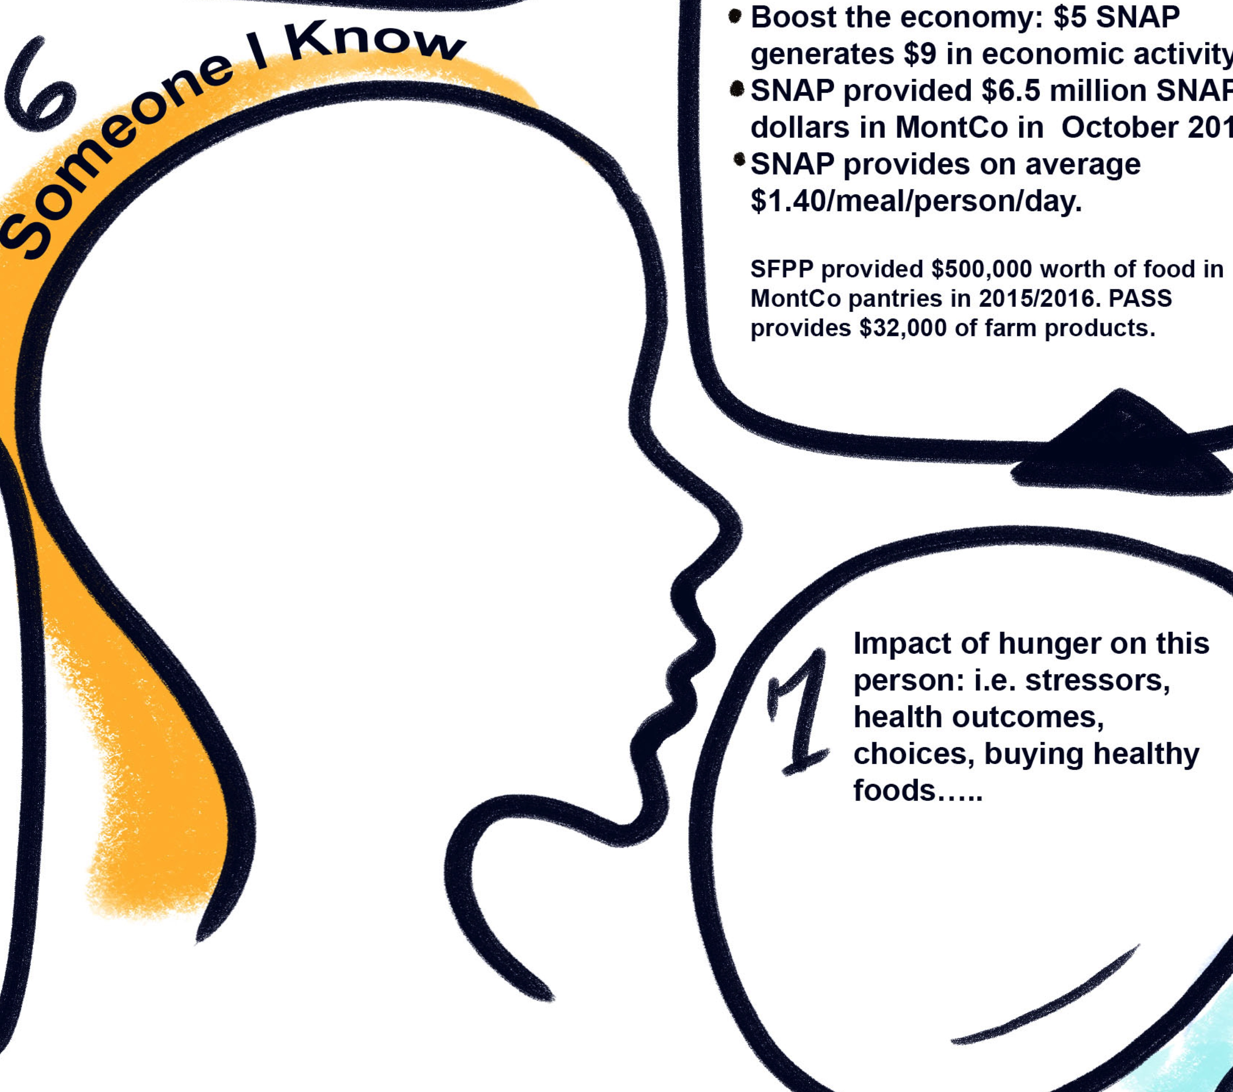

Slide 14
True or False ?
Charities provide more food assistance than government nutrition programs in the U.S.
Notes:
Panties and food donations are WONDERFUL, and a critical piece of responding to immediate need. The foodbank network across America has grown and is now much more a SUPPLEMENTAL food system than an emergency one.

Slide 15

FALSE!
Government-funded programs provide 96% of all food assistance in the United States, charities just 4%.
Notes:
The 96% may be slightly dated given the grown of the Food Bank system, but it’s safe to say gov’t provides at least 90% of food assistance. Donated foods make up a small portion of what is needed. Speak to any church, pantry, non-profit and they will tell you they can not handle the demand for help.

Slide 16

Government Nutrition Programs (Federal & State)
Federal:
Supplemental Nutrition Assistance Program
(SNAP, formerly Food Stamps)
National School Breakfast & Lunch Programs
Special Supplemental Nutrition Program for Women, Infants, and Children (WIC)
Summer Food Service Program (SFSP)
Child and Adult Care Food Program (CACFP)
The Emergency Food Assistance Program (TEFAP)
Commodity Supplemental Food Program (CSFP)
State:
State Food Purchase Program (SFPP)
Pennsylvania Agricultural Surplus System (PASS)
Tax incentives for food and monetary donations
Notes:
We perform both policy advocacy and local program advocacy/support on these programs

Slide 17

ADVOCACY
Advocate (verb): to support or argue for (a cause, policy, etc.); to plead in favor of
Never doubt that a small group of thoughtful, committed citizens can change the world; indeed, it's the only thing that ever has."
- Margaret Mead
Educating
Engaging
Influencing

Slide 18
Can Non-Profits Advocate?
501(h) Election
Annual Exempt-Purpose Expenditures | Total Lobbying Expenditures Allowable | Amount of Total Lobbying Expenditures That Can Be Grassroots Lobbying
Up to $500,000 | 20% of exempt-purpose expenditures, up to $100,000 | One-quarter of the total direct lobbying expenditure ceiling
>$500,000 - $1 million | $100,000 + 15% of excess over $500,000 | $25,000+ 3.75% of excess over $500,000
>$1 million to $1.5 million | $175,000 +10% of excess over $1 million | $43,750 + 2.5% of excess over $1 million
>$1.5 million to $17 million | $225,000 + 5% of excess over $1.5 million | $56,250 + 1.25% of excess over $1.5 million
Over $17 million | $1 million | $250,000
YES!
Plus, as an individual constituent, you can always advocate!

Slide 19
Does Advocacy Work?
  “If your Senator/Rep. has not arrived at a decision on an issue, how much influence might the following strategies directed to his/her D.C. office have?"
Source: Congressional Management Foundation
Notes:
We do have a voice. We elect our representatives and they are responsible to their constituency. They will listen to you. They do care what you think. And we represent constituents, so they will listen to us to. We want to be the hunger expert that they go to when they have a question or idea.

Slide 20

Advocacy Tools
Education/Awareness
Policy Briefs & Fact Sheets
Coalition building
Meetings with elected and
administrative officials
Testimony and comments
Print and social media, e-alerts”
Letters, post cards, petitions,
stories
One of our most important tools: YOUR VOICE!
Notes:
At state & federal level, work to encourage responsible funding & policies re hunger & poverty. Compile annual State of PA hunger report. Educate media and public with data re: hunger, SNAP, etc.
CALL Senators Casey and Toomey and your U.S. Representative (in Philly, could be Rep. Brady, Evans, or Boyle).

Slide 21

Federal Advocacy
Federal nutrition programs are up for renewal every five years and fall under either:
  The Farm Bill (SNAP), or
  The Child Nutrition Act (“Healthy Hunger-Free Kids Act,” Dec. 2010)
  Budgets and appropriations for programs happen annually, which means funding for programs can be at risk each year

Slide 22
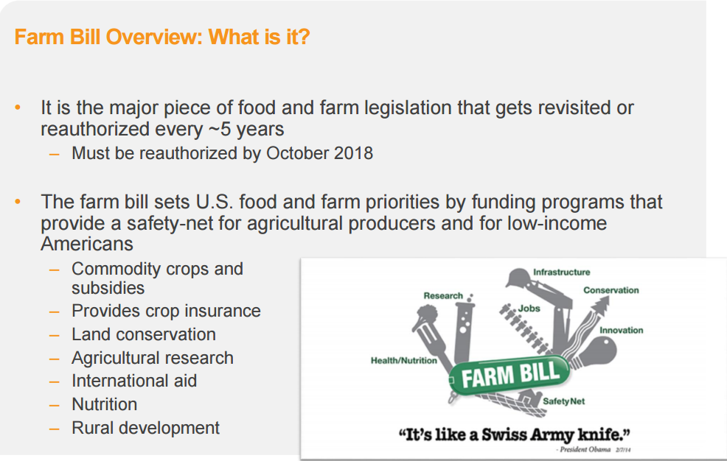
Source: Feeding America

Slide 23

“SNAP” = #1 Defense Against Hunger
“SNAP” - Supplemental Nutrition Assistance Program (food stamps) is the nation’s largest nutrition program
  Meets basic food & nutrition needs while maintaining dignity
  Encourages self-sufficiency
  Redirects money to meet other essential needs
  Boosts the economy (every $5 of SNAP generates $9 in economic activity)
In 2016, SNAP helped lift 340,000 Pennsylvanians out of poverty
  Nationally, half of all children will receive SNAP at some point before age 18

Slide 24
PA SNAP FACTS
PA’s 1.8 million SNAP participants include:
  684,000 children
  194,000 seniors
  335,000 non-elderly disabled individuals
A 10% cut in SNAP in PA would result in a loss of 3,611 jobs
PA SNAP spending accounts for more than 10% of all spending on food purchased to be eaten at home
SNAP benefits funded ~$228,839,794 in PA sales each month in 2016= a total of nearly $2.75 billion in 2016!!!!!

Slide 25

SNAP is Critical for Montgomery County
SNAP helps participants, as well as:
Retailers
Landlords
Utility companies
Farmers
Our entire economy
In an average month of 2016, 52,793 Montgomery County residents received SNAP, providing $6,538,295 to purchase food
Every $1 of SNAP benefits has an estimated $1.70 economic impact. In 2016 SNAP provided a $ bump to the county’s economy

Slide 26

Threats to Food Security at National Level
Changing the structure of SNAP or other nutrition programs (such as “Block” or “Opportunity” grants)
Creating work requirements and/or eliminating geographic waivers for current work rules
Reducing funding for SNAP and other nutrition programs
Ending ACA/drastic changes to Medicaid (higher health costs = less $ for food)
Tax changes, including eliminating tax credits for food and funding donors
Reducing the Earned Income Tax Credit and/or Child Tax Credit

Slide 27

State Level Advocacy
States administer the federal nutrition programs within federal rules. In Pennsylvania:
  Dept. Human Services (DHS) administers SNAP
  Dept. of Education administers school, after-school, summer meals and CACFP
  Dept. of Health administers WIC
  Dept. of Agriculture administers TEFAP
Again, advocacy can be legislative or administrative, for instance:
  Pushing DHS to take a specific federal option, like ESAP
  Asking PDE to include school breakfast and lunch participation rates to its School Performance Profile
  Advocating for additional funding for the State Food Purchase Program, or, fighting against legislation that would harm food insecure persons (SB76)

Slide 28
State Food Purchase Program (SFPP)
SFPP provides money to counties to purchase and distribute food to low-income individuals (150% poverty line).
Montgomery County received $615,432 in FY17
Currently funded at $18.188 M. In the last decade, funding dropped and still has not been restored to its high of $18.75 M in FY06-07. Meanwhile the number of residents eligible for SFPP has grown by 35%, and food costs continue to rise.
Advocating for $21 M for SFPP in FY18 Budget

Slide 29
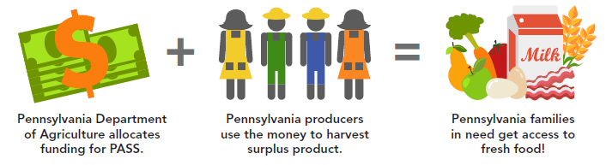
Pennsylvania Agricultural Surplus System (PASS)
Currently funded through SFPP line item at $1 M
We are advocating for an increase to $5 M

Slide 30
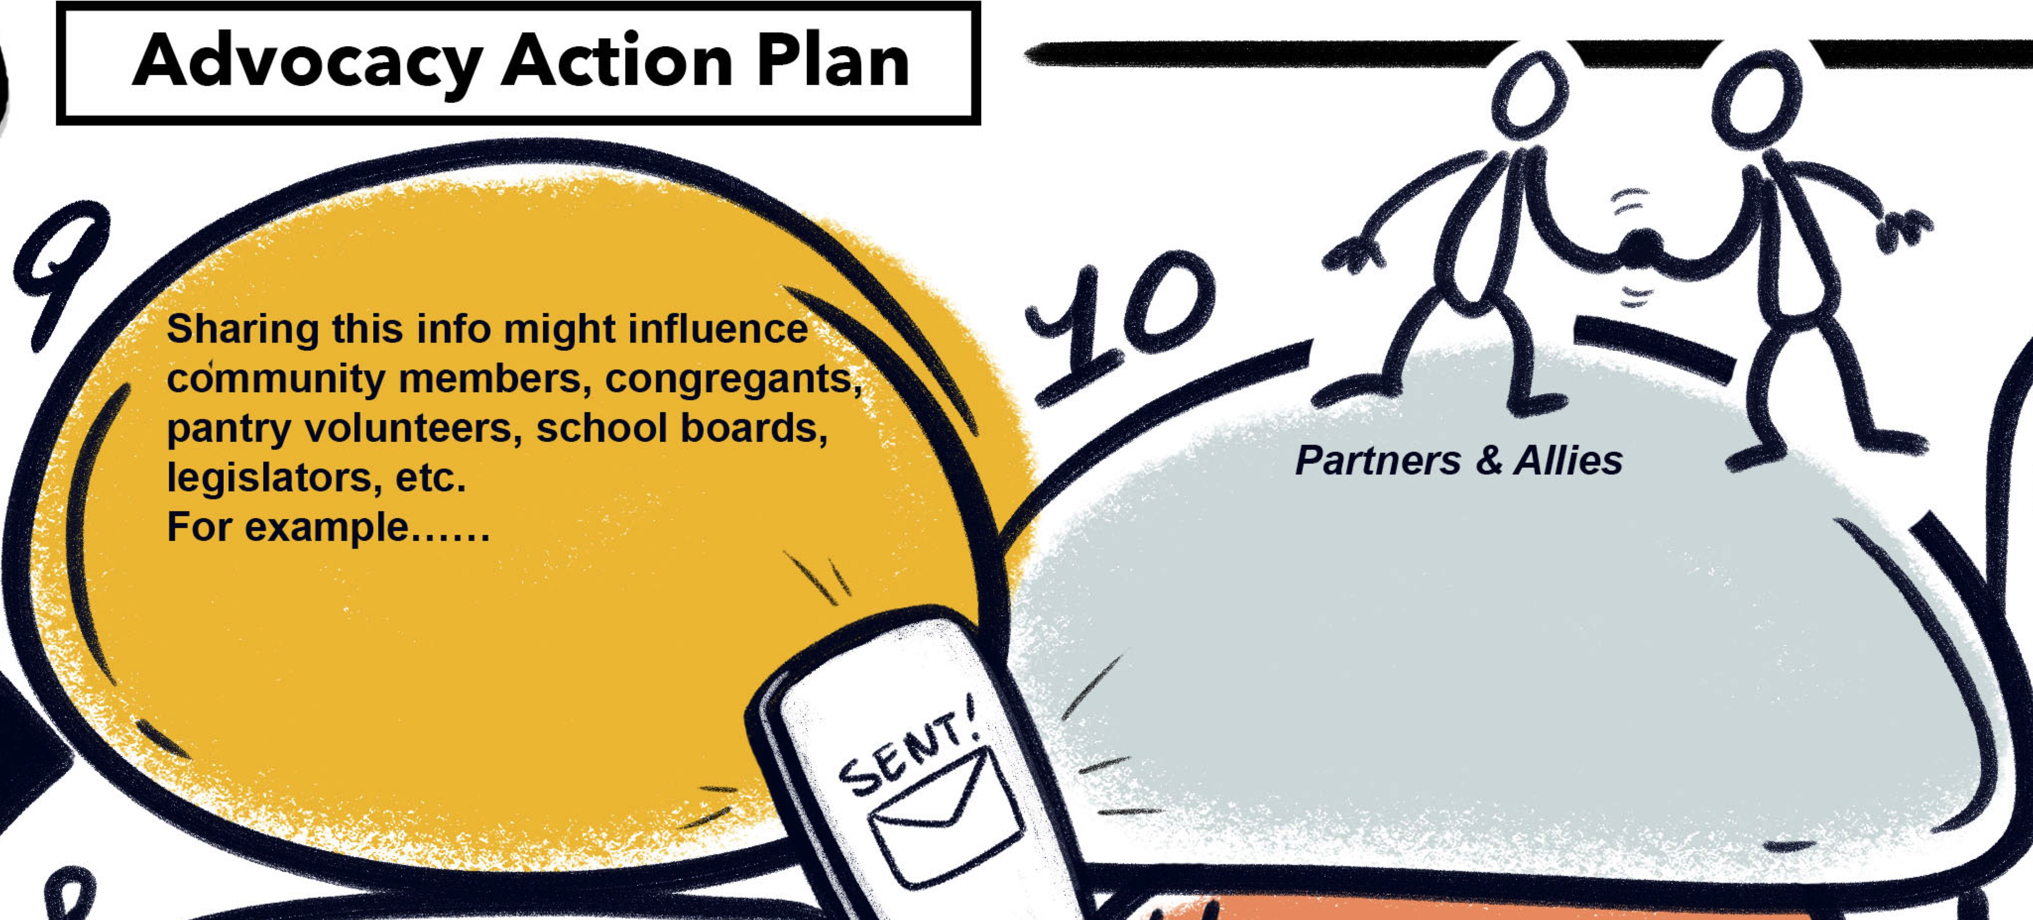

Slide 31
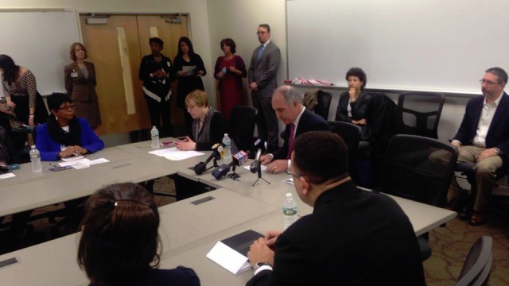
Meeting with Elected Officials: BEFORE the Meeting
Schedule with the DC or District Office a few weeks in advance
Research the Elected Official
  What committees do they sit on?
  Do they have a signature issue?
  Is there anything you should be thanking them for?
  What is their stance on your issues?
  What other information might help you connect with them? Where did they go to school? Where does their partner work?

Slide 32

Meeting with Elected Officials: Planning Meeting Details
Consider inviting other anti-hunger organizations, “non-traditional allies” (grocers, doctors, farmers, etc.), and people experiencing hunger
Prepare/find materials that provide good background on the issue and share with staff at least 3 days prior to the meeting
Plan your agenda, talking points, and “asks” in advance (especially if going with a group). Take time to think of how to align your issue with what they value.

Slide 33
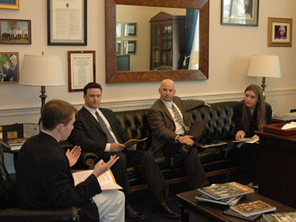
Meeting with Elected Officials: Agenda
Introductions
  Who you are/who you represent
  Note if you are a constituent
Present the issue
  Scope of the issue; your concerns; why this issue matters; why the Rep should care
  Impact of the issue in the Rep’s district (use data when possible)
  Story/personal account of the issue
Make your “ask” – be specific. Examples include:
  Come visit our program
  Introduce this bill
  Co-sponsor this bill
  Sign this letter
  Vote yes/no on this bill
  Ask this question at a hearing

Slide 34
Keep in mind…
Try to get a response on your ask – be direct. If he/she is not ready to respond:
  Try to get an indication of where s/he is leaning
  Ask what additional information would be helpful
  Indicate you will follow up to hear what s/he decides on the issue
Allow the official to ask questions and share feedback
Stress that you are a RESOURCE to the legislator/staff
After the meeting- send a thank you (email is acceptable) and provide any information requested during the meeting

Slide 35
Montgomery County Representatives
  “Find my legislator” at: www.seventy.org/tools/citizen-s-guide
Federal:
Senators: Pat Toomey, Bob Casey
Congressmen: Ryan Costello, Pat Meehan, Brendan Boyle, Lloyd Smucker
State:
Representatives: Madeleine Dean, Mary Jo Daley, Tim Briggs, Thomas Murt, Stephen McCarter, Michael Corr, Marcy Toepel, Justin Simmons, Matthew Bradford, Robert Godshall, Todd Stephens, Thomas Quigley, Kate Harper, Greg Vitali, Pam DeLissio, Tim Hennessey, Kevin Boyle, Warren Kampf
Senators: Art Haywood, Stuart Greenleaf, Daylin Leach, John Rafferty, Vincent Hughes, Bob Mensch

Slide 36

What can you do?
Stay informed, get involved, and take action to help us end hunger!
Sign up for e-newsletters and e-alerts http://action.hungercoalition.org/page/s/
https://www.philabundance.org/contact/advocacy-emails/
Meet your elected official- build a relationship
Tell your elected officials what you think with meetings, letters, phone calls, emails
  Federal: SNAP, TEFAP, School Meals…
  State: SFPP, PASS, administrative issues…
Engage the people you serve in this work
Prepare to mobilize when there are threats
Notes:
4 steps to ending hunger in America-
1) A jobs agenda (higher quality jobs w/better pay and benefits)
2) A stronger safety net w/adequate funding!
3) Human capital development – invest in people to help them build skills!
4) Public-private partnerships to support innovative community-led initiatives against hunger

Slide 37
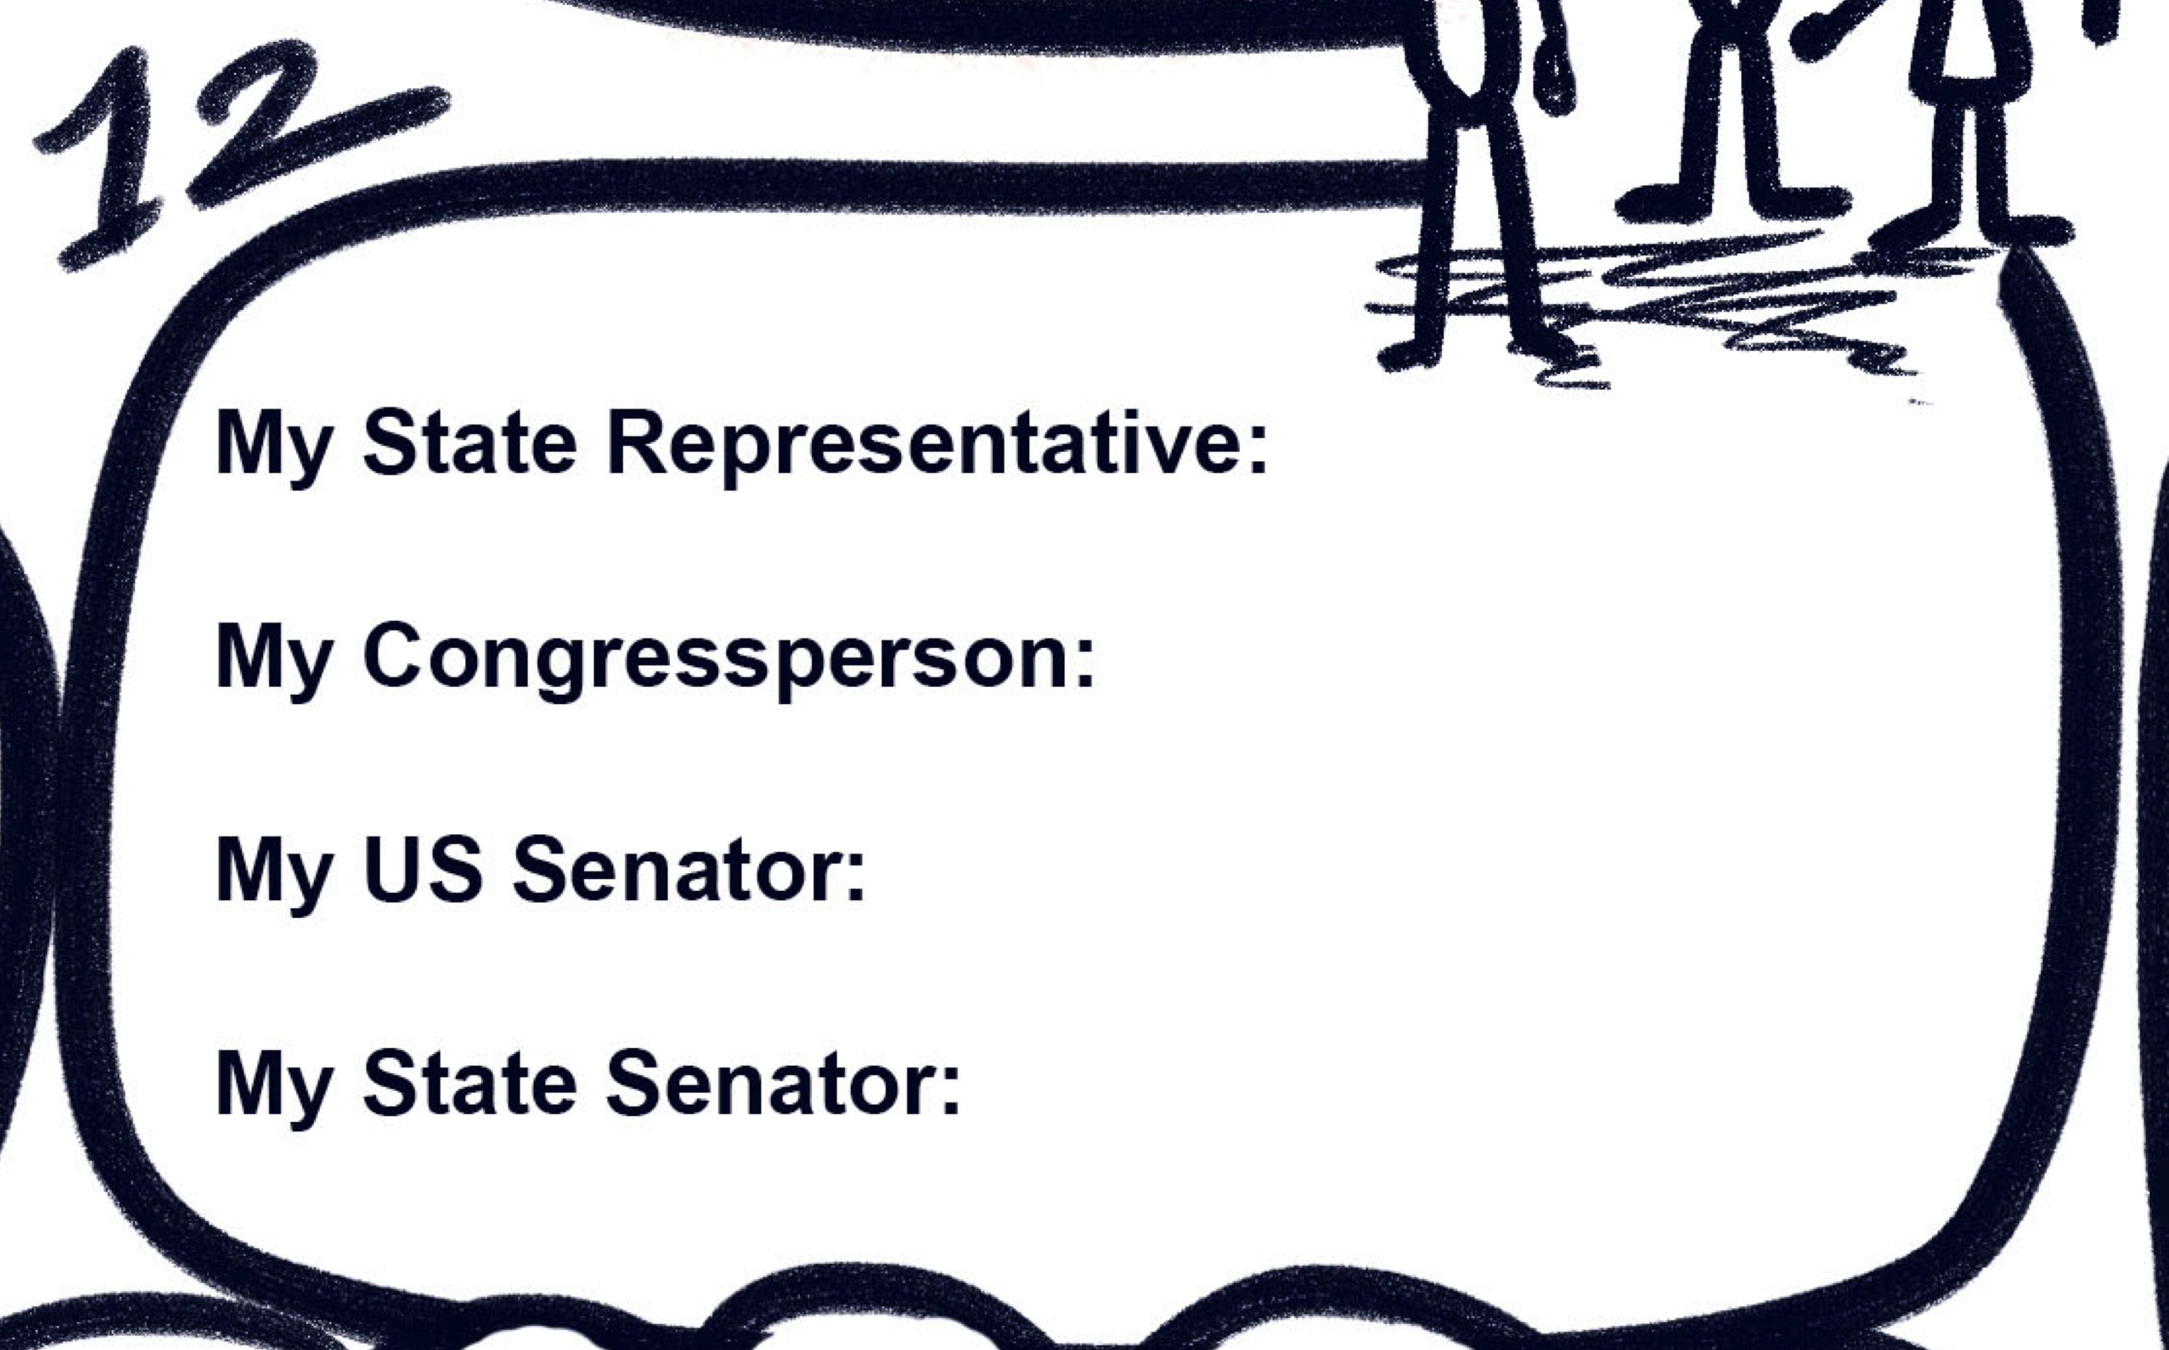

Slide 38

Role Playing
Meeting with PA State Representative to ensure enough money is allotted for the State Food Purchase Program & PASS
Meeting with your US congressman or Senator about hunger and the importance of SNAP and the upcoming farm bill.
Meeting with your school board about the importance of school breakfast programs or summer meals.
Meeting with someone in your community or congregation about advocating for important food programs and policy.
Meeting with your town council or mayor to discuss hunger in the community to find ways to partner and address it.

Slide 39

What are your action steps?

Slide 40

Reflections

